Slide 1
Mentoring

Slide 2
Mentoring
A relationship in which a more experienced or more knowledgeable person helps to guide a less experienced or less knowledgeable person. The Mentor may be older or younger than the person being mentored, but he or she must have a certain area of expertise. It is a learning and development partnership between someone with vast experience and someone who wants to learn.
Wikipedia https://en.wikipedia.org/wiki/Mentorship

Slide 3
Etymology
Notes:
The first recorded use of the word ‘mentor’ is in Homer’s poem The Odyssey. In the odyssey Ulysses left his trusted friend Mentor to take care of his household and his son Telemachus whilst he was away fighting in the Trojan War.
Mentor largely failed in his duties, taking care of neither.
It was the goddess of war and of wisdom(Pallas Athene ) who helped Telemachus, appearing throughout The Odyssey in a variety of human and animal forms, including that of Mentor.
As Mentor she acted as a wise and trusted adviser helping Telemachus grow in experience, maturity and courage.

Slide 4
Etymology
Notes:
The odyssey was written around 8th century BC However, the word didn’t feature in the English language until publication in 1750 of the story The adventures of Telemachus, by the French writer Fénelon, in which Mentor was the main character.
Because of the role of Mentor and the goddess of war and wisdom in the odyssey the personal name Mentor has been adopted in Latin and other languages, including English, as a term meaning someone who shares knowledge with a less-experienced colleague.

Slide 5
Mentoring
Coaching
!=
Notes:
The terms mentoring and coaching often get used interchangeably. Both are similar in their support of someone's development, but they involve very different disciplines in practice.

Slide 6
Coaching
Coaching is a form of development in which a person called a coach supports a learner or client in achieving a specific personal or professional goal by providing training and guidance…coaching differs from mentoring in focusing on specific tasks or objectives
Wikipedia https://en.wikipedia.org/wiki/Coaching
Notes:
Coaching is a process that aims to improve performance and focuses on the ‘here and now’ rather than on the distant future

Slide 7
Mentoring vs Coaching
Mentoring | Coaching
Relationship oriented | Task oriented
Long term | Short term
Development driven | Performance driven
Usually a team member | Usually the manager
Informal | Formal
Notes:
While coaching focus is on concrete and specific issues Mentoring takes a broader view of the person, is centered not only around professional growth but on personal success success as well. work/life balance, self-confidence, self-perception.
Mentoring, to be successful, requires time in which both the mentor and the mentee can learn about one another and build trust that creates an environment in which the mentee can feel secure in sharing the real issues that impact his or her success.
Coaching is short term. A coach can successfully be involved with a coachee for a short period of time, maybe even just a few sessions. Usually he coaching lasts for as long as is needed
Mentoring purpose is to develop the individual not only for the current job, but also for the future. The purpose of coaching on the other hand is to improve the individual's performance on the job.
In mentoring, the immediate manager is not directly involved. Although she or he may offer suggestions to the employee on how to best use the mentoring experience or may provide a recommendation to the matching committee on what would constitute a good match, the manager has no link to the mentor and they do not communicate at all during the mentoring relationship. This helps maintain the mentoring relationship's integrity.
The coachee's immediate manager is a critical partner in coaching. She or he often provides the coach with feedback on areas in which his or her employee is in need of coaching. This coach uses this information to guide the coaching process
More informal and meetings can take place as and when the mentored individual needs some guidance and or support
Structured in nature and meetings scheduled on a regular basis

Slide 8
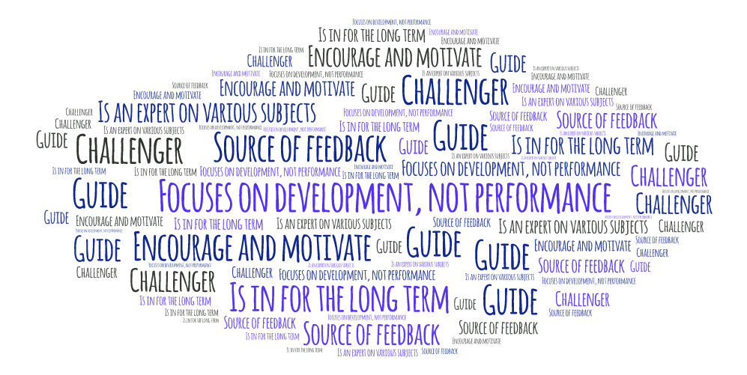
Who’s the mentor?
Notes:
The mentor is a expert on various subjects. He’s focused on the development of the mentees and not their performance
He needs to help the mentee to identify strengths and weaknesses and consequently areas to work on
In particular the mentor needs to help the mentee to identify the area in which he wants to grow and help him to move along the journey at their own pace.
As we mentioned earlier the mentor is in for the long term, mentoring to be successful is built on long-term relationships, driven by trust, where the mentor learns the strengths, weaknesses, goals and needs of the mentee.
Finally the mentor needs to provide constructive feedback
a good mentor recognises that despite their experience they have limitations and that their mentee’s path may differ from their own
Role model to promote and encourage positive behaviours in others
Encourage and motivate

Slide 9
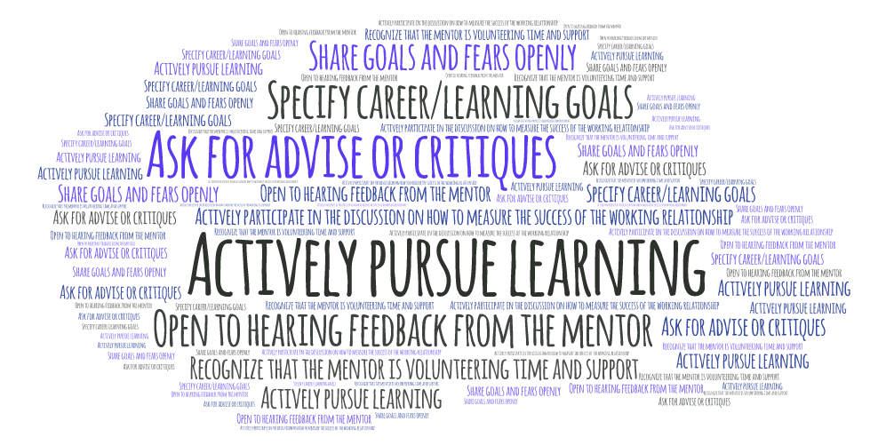
Who’s the mentee?
Notes:
The mentee is someone who’s actively pursuing learning
He needs to Actively work on identifying career/learning goals
Ask for advise or critiques
Needs to be Open to hearing feedback from the mentor
Doesn’t expect from the mentor political support in the organization. For example for a promotion
Showing that you value the mentor's support.
Discuss with your mentor how you can best measure the success and effectiveness of your working relationship together.
Listening carefully and then researching and applying the mentor's guidance.
Not expecting the mentor to do the work for you
Open to hearing feedback from the mentor
Actively participate in the discussion on how to measure the success of the working relationship
Recognize that the mentor is volunteering time and support

Slide 10
Good Mentoring
Ask questions
Be clear on where the line is drawn between mentor responsibilities and those of the manager
Agree on goals for the mentoring relationship
Act as a colleague first, an expert second
Set realistic expectations
Evaluate progress periodically
Lets the mentee lead
Notes:
Agree on goals for the mentoring relationship and write them down
Be clear on where the line is drawn between your responsibilities and those of the manager
Act as a colleague first, an expert second. A know-it-all approach to mentoring is intimidating and will limit your successes.
Set realistic expectations. You can provide your protégée access to resources and people, but make it clear you do not wield your influence over others.
Teach your protégée how to become a mentor herself – by example and by encouragement
Ask questions: what are your goals? Where do you see yourself in a year?
Teach your mentee how to become a mentor herself
…lets the mentee lead: mentoring is a process of personal development and as such the individual mentee knows the areas they wish to improve in. Mentors allow mentees to identify areas of personal concern rather than making judgements on the best areas to focus on, although advice can be given if requested.

Slide 11
I never mentored anyone how do I start?

Slide 12
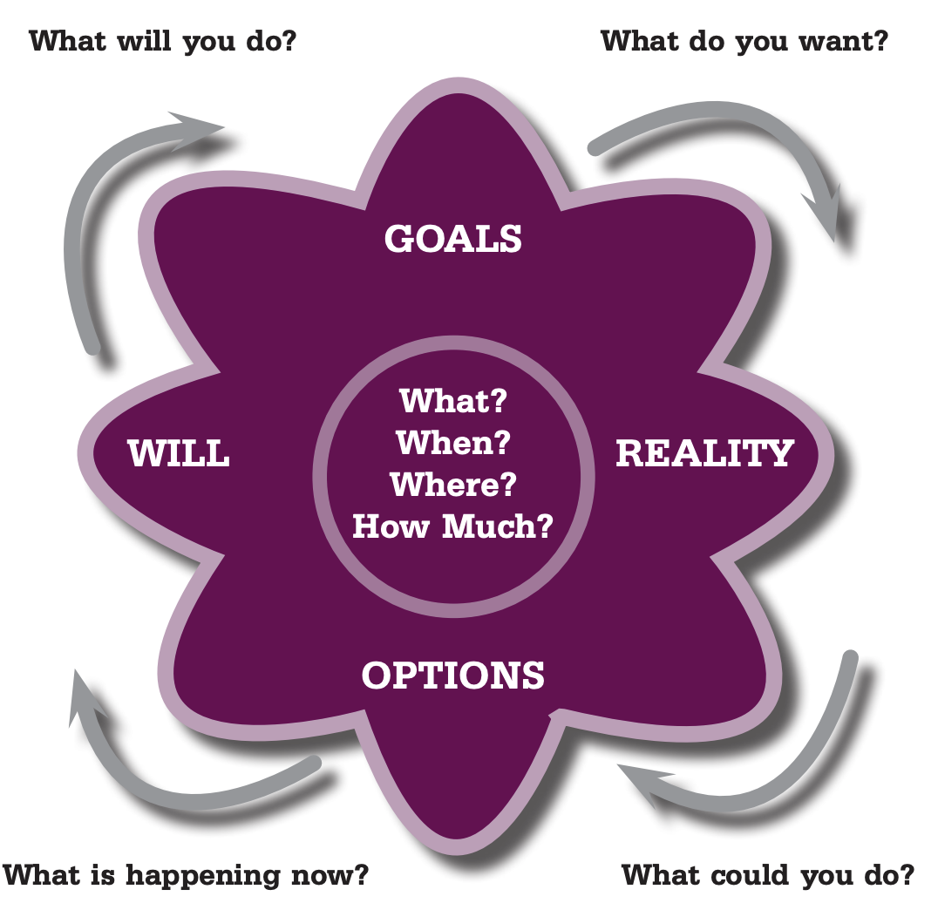
GROW Model
Notes:
The GROW model is a good way to structure a meeting with your mentee.
Goal – Get the mentee to focus on the future and on what THEY want to achieve as an individual. It is not where you think they should be aiming.
Reality – Ask questions to help the mentee establish where they are now.
Encourage the individual to get feedback on their performance from their direct line manager or peers
help them to identify their current reality.
Options – help the mentee to identify what different options are open to them and ask questions to help them explore the reality of each of these options.
Share your own experiences if the mentee is struggling to identify sufficient options and beware of being too directive.
Way Forward – Encourage the mentee to design an action plan which they have set and encourage them to set SMART objectives, objectives that are specific, measurable, achievable and realistic for the mentee in their current position and that have clear timescales attached.
Make sure that the objectives and plan are documented so you can review them in the future

Slide 13
Why? Benefits for mentees
Exposure to new ideas and ways of thinking
Advice on developing strengths and overcoming weaknesses
Guidance on professional development and advancement
Learn to take better control of his or her career
Opportunity to develop new skills and knowledge

Slide 14
Why? Benefits for mentors
Recognition as a subject matter expert and leader
Exposure to fresh perspectives, ideas and approaches
Extension of their professional development record
Opportunity to reflect on their own goals and practices
Development of their personal leadership skills
Increase the mentor's sense of self-worth
Improve communication skills

Slide 15
Why? Benefits for the company
Develop a culture of personal and professional growth
Share desired company behaviours and attitudes
Enhance leadership and coaching skills
Improve staff morale, performance and motivation
Engage, retain and develop performers
Helps grow a company’s talent pool from within

Slide 16
Questions
Is it worth promote mentoring?
1
Are you mentoring anyone?
2
Does your idea of mentoring match my description?
3
Any bad experience with mentoring?
4

